Slide 1
Chapter 2: ANOVA and Regression
2.1 Graphical Analysis
2.2 One-Way ANOVA
2.3 ANOVA Post Hoc Tests
2.4 Pearson Correlation
2.5 Simple Linear Regression

Slide 2
Chapter 2: ANOVA and Regression
2.1 Graphical Analysis
2.2 One-Way ANOVA
2.3 ANOVA Post Hoc Tests
2.4 Pearson Correlation
2.5 Simple Linear Regression

Slide 3
Objectives
Explain what an association is.
Graphically explore associations in the AmesHousing3 data set.

Slide 4
Associations
An association exists between two variables when the expected value of one variable differs at different levels of the other variable.
A linear association between two continuous variables can be inferred when the general shape of a scatter plot of the two variables is a straight line.

Slide 5
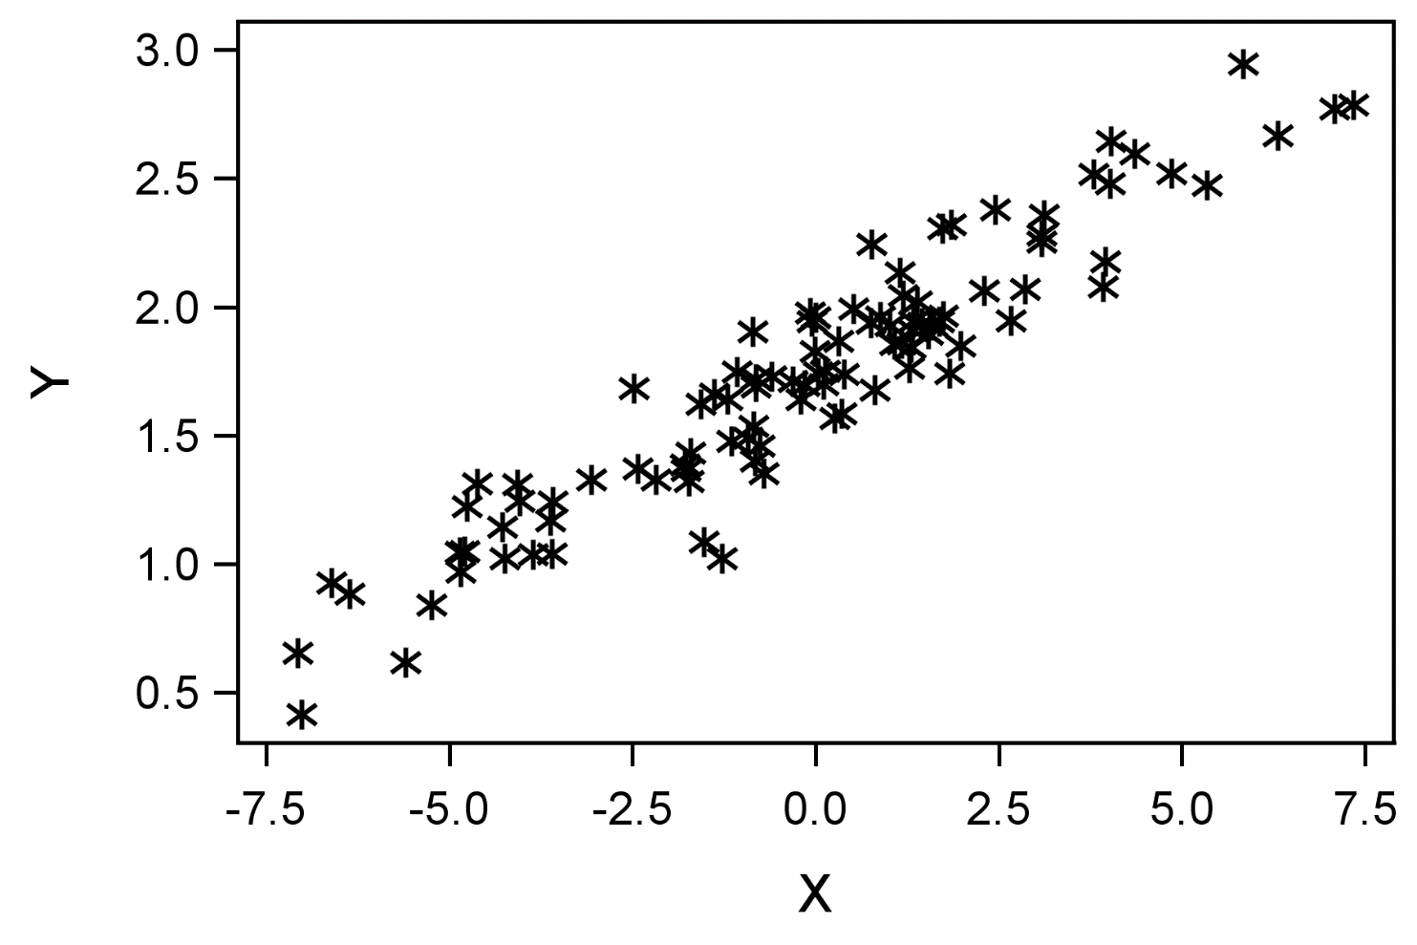
Scatter Plots

Slide 6
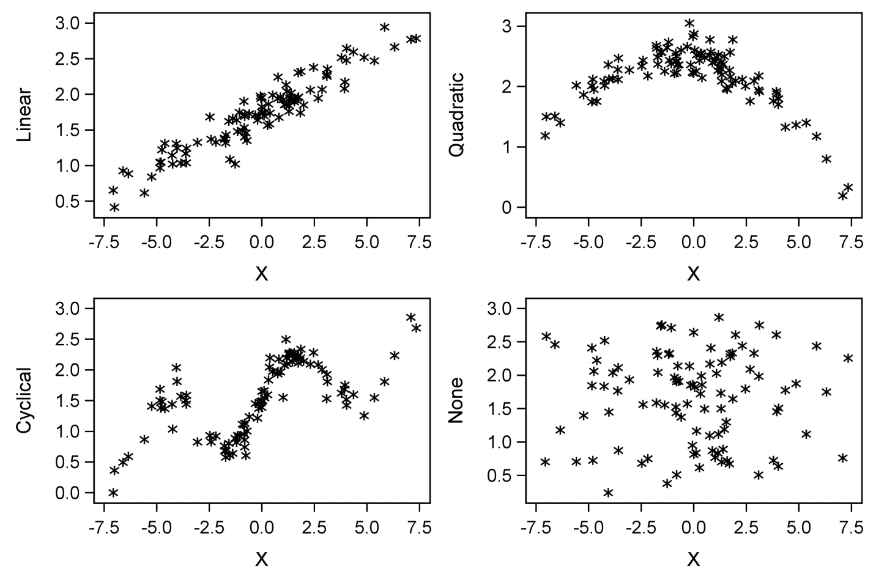
Relationships between Continuous Variables

Slide 7
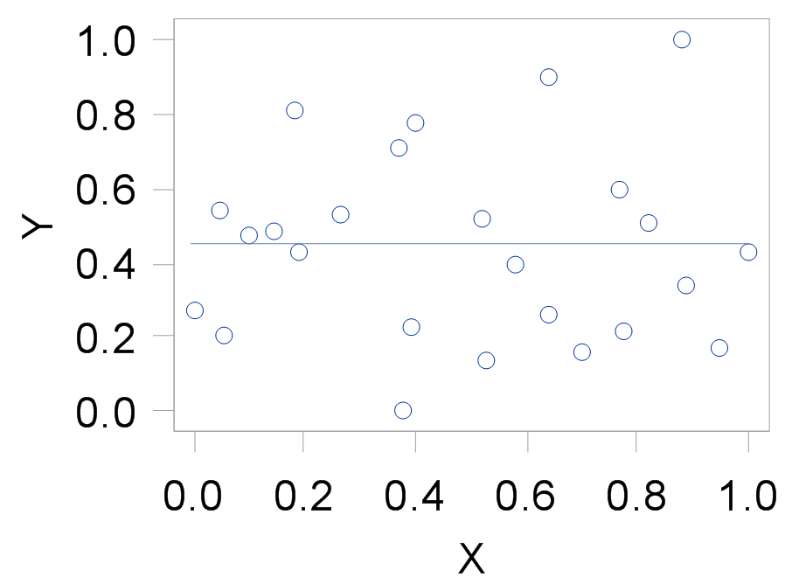
No Association – Continuous Predictor

Slide 8
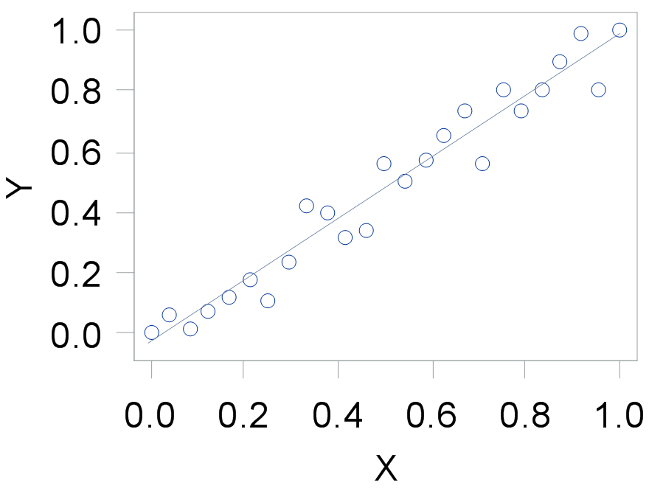
Linear Association – Continuous Predictor

Slide 9
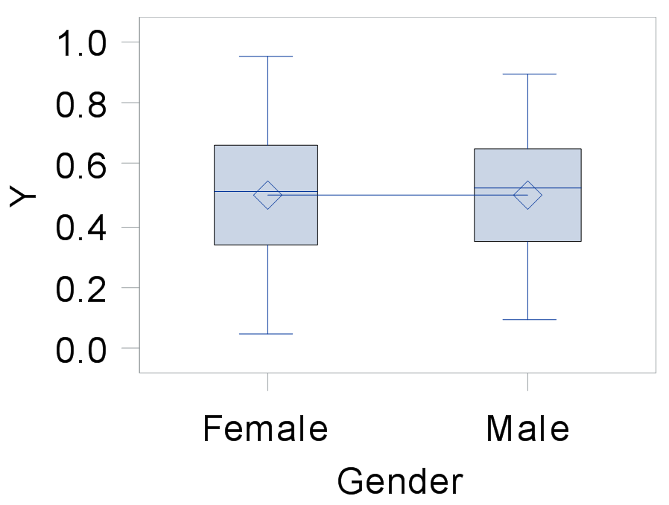
No Association – Categorical Predictor

Slide 10
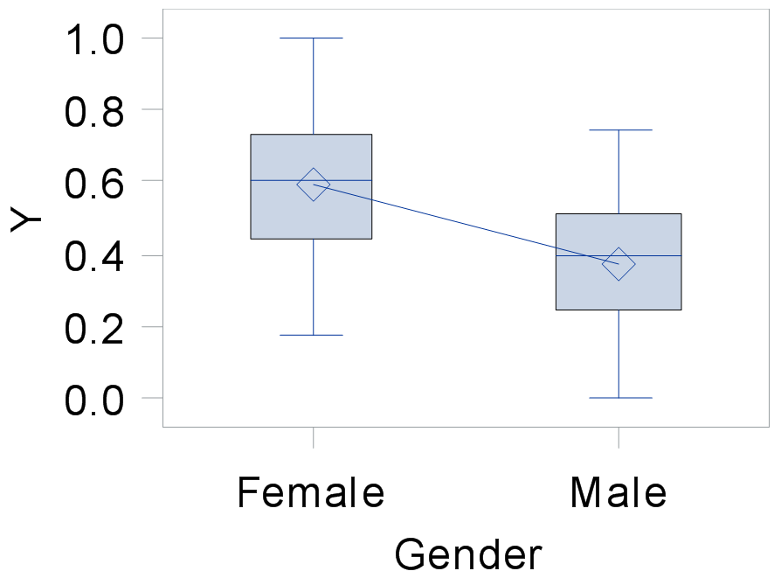
Association – Categorical Predictor

Slide 11
2.01 Multiple Answer Poll
What is the visual cue in a scatter plot that there is no association between the response variable and the explanatory variables?
All of the y values fall on a straight line.
None of the y values fall on a straight line.
All of the y mean values fall on a straight line.
None of the y mean values fall on a straight line.
All of the y values are the same.
All of the y mean values are the same.
Notes:
Correct Answers: E, F,
However, if the y values are all the same, then there might be problems in your data collection or measurement.

Slide 12
2.01 Multiple Answer Poll – Correct Answers
What is the visual cue in a scatter plot that there is no association between the response variable and the explanatory variables?
All of the y values fall on a straight line.
None of the y values fall on a straight line.
All of the y mean values fall on a straight line.
None of the y mean values fall on a straight line.
All of the y values are the same.
All of the y mean values are the same.
However, if the y values are all the same, then there might be problems in your data collection or measurement.
Notes:
Correct Answer: E, F,

Slide 13
Exploring Associations
This demonstration illustrates the concepts discussed previously.

Slide 14
Chapter 2: ANOVA and Regression
2.1 Graphical Analysis
2.2 One-Way ANOVA
2.3 ANOVA Post Hoc Tests
2.4 Pearson Correlation
2.5 Simple Linear Regression

Slide 15
Objectives
Use the GLM procedure to analyze the differences between population means.
Verify the assumptions of analysis of variance.

Slide 16
Overview of Statistical Models
Type of Predictors Type of Response | Categorical | Continuous | Continuous and Categorical
Continuous | Analysis of Variance (ANOVA) | Ordinary Least Squares (OLS) Regression | Analysis of Covariance (ANCOVA)
Categorical | Contingency Table Analysis or Logistic Regression | Logistic Regression | Logistic Regression

Slide 17
Overview
Are there any differences among the population means?
Another way of asking: Does information about group membership help predict the level of a numeric response?
Response
Predictor
Categorical
Continuous
One-Way ANOVA

Slide 18

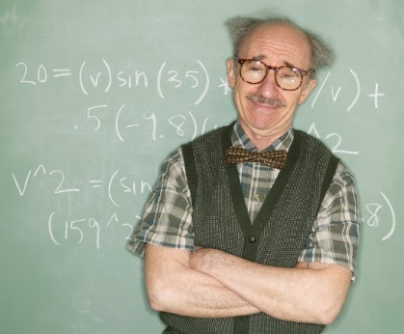
Research Questions for One-Way ANOVA
Do accountants, on average, earn more than teachers? *
* Is this a case for a t test?

Slide 19

Research Questions for One-Way ANOVA
Do people treated with one of two new drugs have higher average T-cell counts than people in the control group?
Placebo
Treatment 1
Treatment 2

Slide 20
Research Questions for One-Way ANOVA
Do people spend different amounts depending on which type of credit card they have?

Slide 21
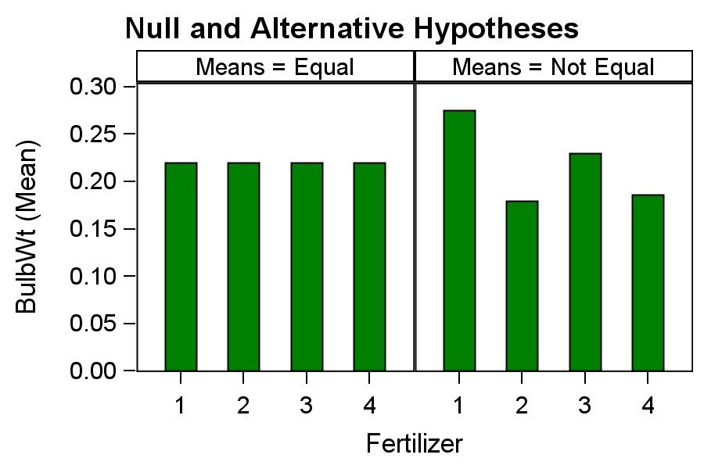
The ANOVA Hypothesis
H₁: F1 ≠ F2 or F1 ≠ F3
or F1 ≠ F4 or F2 ≠ F3
or F2 ≠ F4 or F3 ≠ F4
H₀: F1=F2=F3=F4

Slide 22
Partitioning Variability in ANOVA
Variability between Groups
Variability within Groups
Total Variability
SS_{T} = SS_{M} + SS_{E}

Slide 23
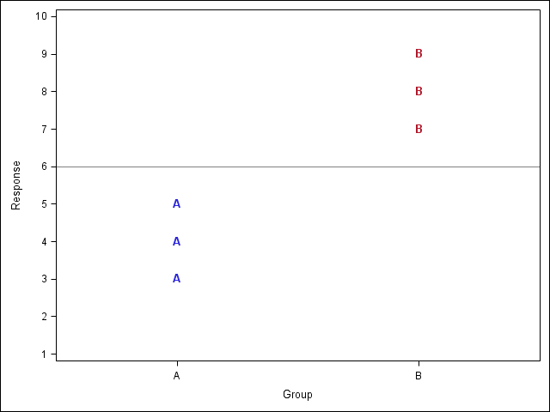
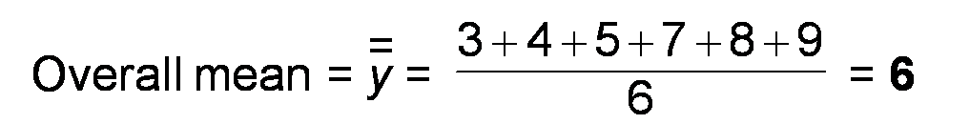
Sums of Squares

Slide 24
Total Sum of Squares
(7-6)²
(3-6)²
SS_{T} = (3-6)² + (4-6)² + (5-6)² + (7-6)² + (8-6)² + (9-6)² = 28

Slide 25
Error Sum of Squares
(7-8)²
(5-4)²
SS_{E} = (3-4)² + (4-4)² + (5-4)² + (7-8)² + (8-8)² + (9-8)² = 4

Slide 26
Model Sum of Squares
(8-6)²
(4-6)²
SS_{M} = 3*(4-6)² + 3*(8-6)² = 24

Slide 27
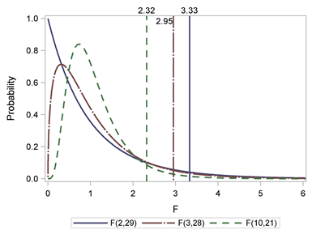
F Statistic and Critical Values at α=0.05
F(Model df, Error df)=MS_{M} / MS_{E}

Slide 28
Coefficient of Determination
“Proportion of variance accounted for by the model”

Slide 29

The ANOVA Model
Base Level
Unaccounted for Variation
Central_Air
SalePrice = + +
Y_{ik} = μ + τ_{i} + ε_{ik}

Slide 30
2.02 Multiple Answer Poll
What does the R-Square value measure?
The correlation between the independent and dependent variables.
The proportion of total sum of squares accounted for by the model.
Model sum of squares over error sum of squares.
Something to do with variability.
Notes:
Answers are b and d.

Slide 31
2.02 Multiple Answer Poll – Correct Answers
What does the R-Square value measure?
The correlation between the independent and dependent variables.
The proportion of total sum of squares accounted for by the model.
Model sum of squares over error sum of squares.
Something to do with variability.
Notes:
Answers are b and d.

Slide 32
The GLM Procedure
General form of the GLM procedure:
PROC GLM DATA=SAS-data-set PLOTS=options;
CLASS variables;
MODEL dependents=independents </ options>;
MEANS effects </ options>;
LSMEANS effects </ options>;
OUTPUT OUT=SAS-data-set keyword=variable…;
RUN;
QUIT;

Slide 33
What Does a CLASS Statement Actually Do?
The CLASS statement creates a set of “design variables” representing the information in the categorical variables.
PROC GLM performs linear regression on the design variables, but reports the output in a manner interpretable as group mean differences.
Note: There is only one “parameterization” available in PROC GLM.

Slide 34
GLM Coding of CLASS Variables
Design Variables
CLASS Value Label 1 2 3
IncLevel 1 Low Income 1 0 0
2 Medium Income 0 1 0
3 High Income 0 0 1

Slide 35
Assumptions for ANOVA
Observations are independent.
Errors are normally distributed.
All groups have equal error variances.
Notes:
Talk about what independence means here.

Slide 36
Assessing ANOVA Assumptions
In many cases, good data collection designs can help ensure the independence assumption.
Diagnostic plots from PROC GLM can be used to verify the assumption that the error is approximately normally distributed.
PROC GLM produces a test of equal variances with the HOVTEST option in the MEANS statement. H0 for this hypothesis test is that the variances are equal for all populations.

Slide 37
Predicted and Residual Values
The predicted value in ANOVA is the group mean. A residual is the difference between the observed value of the response and the predicted value of the response variable.
Observation | Heating_QC | Observed | Predicted | Residual
1 | Ex | 213500.0000 | 154919.1869 | 58580.8131
2 | Ex | 191500.0000 | 154919.1869 | 36580.8131
3 | TA | 115000.0000 | 130573.5294 | -15573.5294
4 | Ex | 160000.0000 | 154919.1869 | 5080.8131
5 | Ex | 180000.0000 | 154919.1869 | 25080.8131
6 | TA | 125000.0000 | 130573.5294 | -5573.5294
7 | TA | 206000.0000 | 130573.5294 | 75426.4706
8 | Gd | 159000.0000 | 130844.0862 | 28155.9138
9 | TA | 180500.0000 | 130573.5294 | 49926.4706
10 | Gd | 142125.0000 | 130844.0862 | 11280.9138

Slide 38
2.03 Multiple Choice Poll
If you have 20 observations in your ANOVA and you calculate the residuals, to which of the following would they sum?
-20
0
20
400
Unable to tell from the information given
Notes:
The answer is b.

Slide 39
2.03 Multiple Choice Poll – Correct Answer
If you have 20 observations in your ANOVA and you calculate the residuals, to which of the following would they sum?
-20
0
20
400
Unable to tell from the information given
Notes:
The answer is b.

Slide 40
2.04 Multiple Choice Poll
If you have 20 observations in your ANOVA and you calculate the squared residuals, to which of the following would they sum?
-20
0
20
400
Unable to tell from the information given
Notes:
The answer is e.

Slide 41
2.04 Multiple Choice Poll – Correct Answer
If you have 20 observations in your ANOVA and you calculate the squared residuals, to which of the following would they sum?
-20
0
20
400
Unable to tell from the information given
Notes:
The answer is e.

Slide 42
The GLM Procedure for ANOVA
This demonstration illustrates the concepts discussed previously.

Slide 43
Analysis Plan for ANOVA – Summary
Null Hypothesis: All means are equal.
Alternative Hypothesis: At least one mean is different.
Produce descriptive statistics and plots.
Verify assumptions.
Independence
Errors are normally distributed.
Error variances are equal for all groups.
Examine the p-value in the ANOVA table. If the p-value is less than alpha, reject the null hypothesis.

Slide 44
Questions?

Slide 45
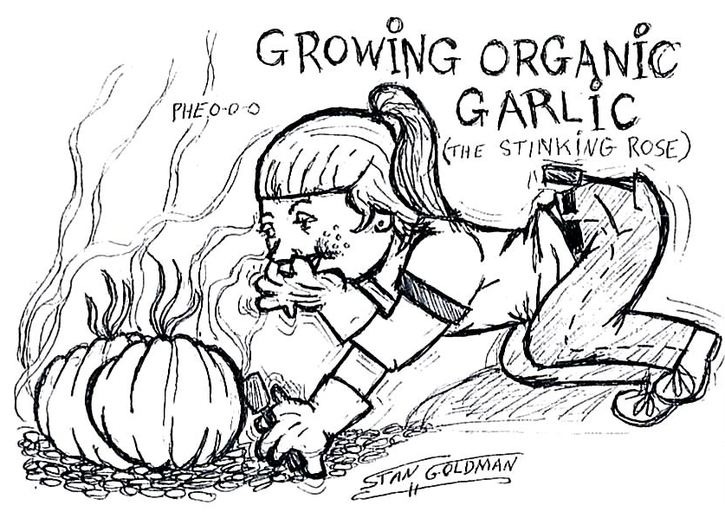
Garlic Example

Slide 46
Exercise
This exercise reinforces the concepts discussed previously.
Notes:
Exercise 2

Slide 47
Chapter 2: ANOVA and Regression
2.1 Graphical Analysis
2.2 One-Way ANOVA
2.3 ANOVA Post Hoc Tests
2.4 Pearson Correlation
2.5 Simple Linear Regression

Slide 48
Objectives
Perform pairwise comparisons among groups after finding a significant effect of an independent variable in ANOVA.
Demonstrate graphical features in PROC GLM for performing post hoc tests.
Interpret a diffogram.
Interpret a control plot.

Slide 49
2.05 Multiple Choice Poll
With a fair coin, your probability of getting heads on one flip is 0.5. If you flip a coin once and got heads, what is the probability of getting heads on the second try?
0.50
0.25
0.00
1.00
0.75
Notes:
The answer is a.

Slide 50
2.05 Multiple Choice Poll – Correct Answer
With a fair coin, your probability of getting heads on one flip is 0.5. If you flip a coin once and got heads, what is the probability of getting heads on the second try?
0.50
0.25
0.00
1.00
0.75
Notes:
The answer is a.

Slide 51
2.06 Multiple Choice Poll
With a fair coin, your probability of getting heads on one flip is 0.5. If you flip a coin twice, what is the probability of getting at least one head out of two?
0.50
0.25
0.00
1.00
0.75
Notes:
The answer is e.
The only way to not get at least one head is to get 2 tails and the probability of that is 0.5 squared, which is 0.25. The probability of anything else (at least one head) is 1.00-0.25=0.75.

Slide 52
2.06 Multiple Choice Poll – Correct Answer
With a fair coin, your probability of getting heads on one flip is 0.5. If you flip a coin twice, what is the probability of getting at least one head out of two?
0.50
0.25
0.00
1.00
0.75
Notes:
The answer is e.
The only way to not get at least one head is to get 2 tails and the probability of that is 0.5 squared, which is 0.25. The probability of anything else (at least one head) is 1.00-0.25=0.75.

Slide 53
Multiple Comparison Methods
Comparisonwise Error Rate = α = 0.05
EER ≤ 1 – (1 – α)^{nc} where nc=number of comparisons
Number of Comparisons
Number of Groups Compared | Number of Comparisons | Experimentwise Error Rate (α=0.05)
2 | 1 | .05
3 | 3 | .14
4 | 6 | .26
5 | 10 | .40
1
3
6
10

Slide 54
Multiple Comparison Methods
Control Comparisonwise Error Rate |  | Pairwise t-tests
Control Experimentwise Error Rate |  | Compare All Pairs Tukey Compare to Control Dunnett

Slide 55
Tukey’s HSD Test
HSD=Honest Significant Difference
This method is appropriate when you consider pairwise comparisons.
The experimentwise error rate is
equal to alpha when all pairwise comparisons are considered
less than alpha when fewer than all pairwise comparisons are considered.
Also known as the Tukey-Kramer Test

Slide 56
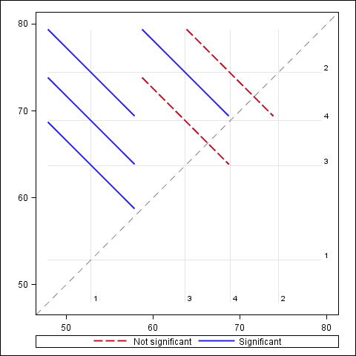
Diffograms

Slide 57
Special Case of Comparing to a Control
Comparing to a control is appropriate when there is a natural reference group, such as a placebo group in a drug trial.
Experimentwise error rate is no greater than the stated alpha.
Comparing to a control takes into account the correlations among tests.
One-sided hypothesis tests against a control group can be performed.
Control comparison computes and tests k-1 groupwise differences, where k is the number of levels of the CLASS variable.
An example is the Dunnett method.

Slide 58
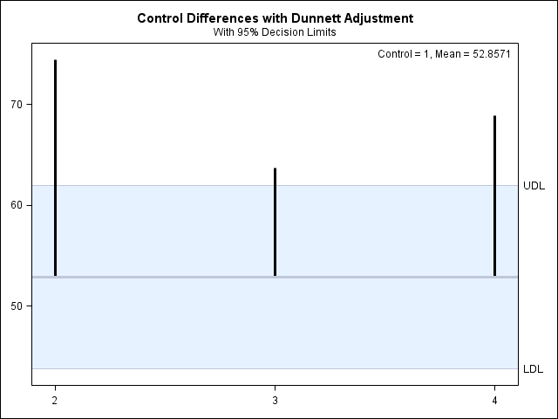
Control Plots

Slide 59
Post Hoc Pairwise Comparisons
This demonstration illustrates the concepts discussed previously.

Slide 60
Questions?

Slide 61
Exercise
This exercise reinforces the concepts discussed previously.

Slide 62
Chapter 2: ANOVA and Regression
2.1 Graphical Analysis
2.2 One-Way ANOVA
2.3 ANOVA Post Hoc Tests
2.4 Pearson Correlation
2.5 Simple Linear Regression

Slide 63
Objectives
Use a scatter plot to examine the linear relationship between two continuous variables.
Use correlation statistics to quantify the degree of association between two continuous variables.
Describe potential misuses of the correlation coefficient.
Use the CORR procedure to obtain Pearson correlation coefficients.

Slide 64
Pearson Correlation – Linear Relationships

Slide 65
Correlation

Slide 66
Hypothesis Test for a Correlation
The parameter representing correlation is ρ.
ρ is estimated by the sample statistic r.
H₀: ρ=0
Rejecting H0 indicates only great confidence that ρ is not exactly zero.
A p-value does not measure the magnitude of the association.
Sample size affects the p-value.

Slide 67
2.07 Multiple Answer Poll
Which of the following statements is/are true?
A Pearson correlation coefficient is a measure of linear association.
A nonsignificant p-value for a Pearson correlation means no relationship.
A negative Pearson correlation indicates a low degree of linear association.
A random cloud of data implies a negative correlation.
Notes:
Type answer here

Slide 68
2.07 Multiple Answer Poll – Correct Answer
Which of the following statements is/are true?
A Pearson correlation coefficient is a measure of linear association.
A nonsignificant p-value for a Pearson correlation means no relationship.
A negative Pearson correlation indicates a low degree of linear association.
A random cloud of data implies a negative correlation.
Notes:
Correct Answer: a

Slide 69
Cautions in Interpreting Correlations
Correlation between X and Y does not imply causation because:
It does not imply the direction of any possible causal relationship between X and Y
There might be a third variable that is the cause of changes in both variables, which means the association between X and Y is only indirect.
The Pearson Correlation only measures the linear association between X and Y.

Slide 70

Correlation versus Causation

Slide 71
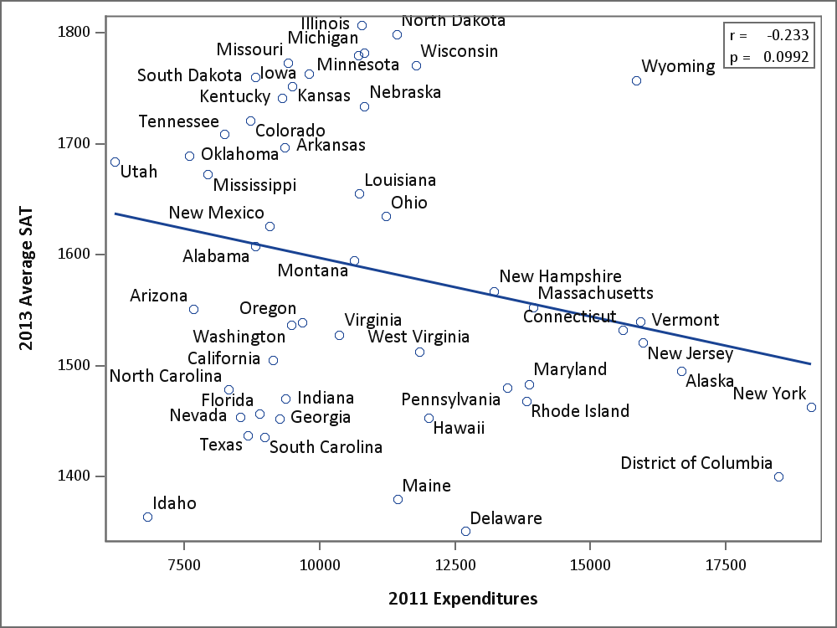
Bivariate Correlations – Partial Story

Slide 72
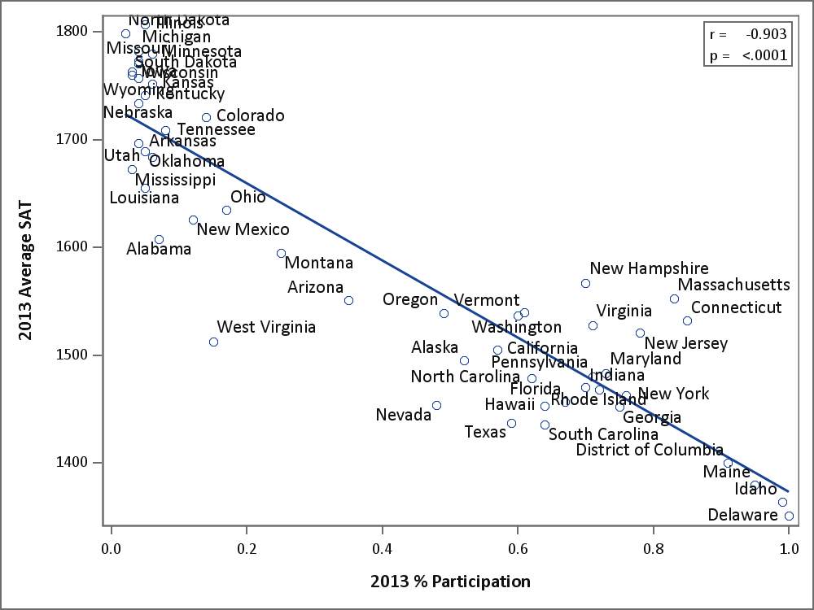
Missing Link

Slide 73
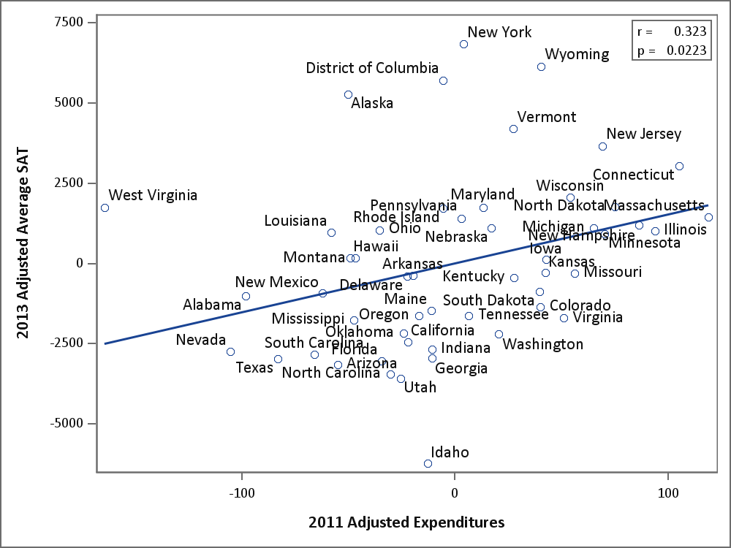
The Truer Story

Slide 74
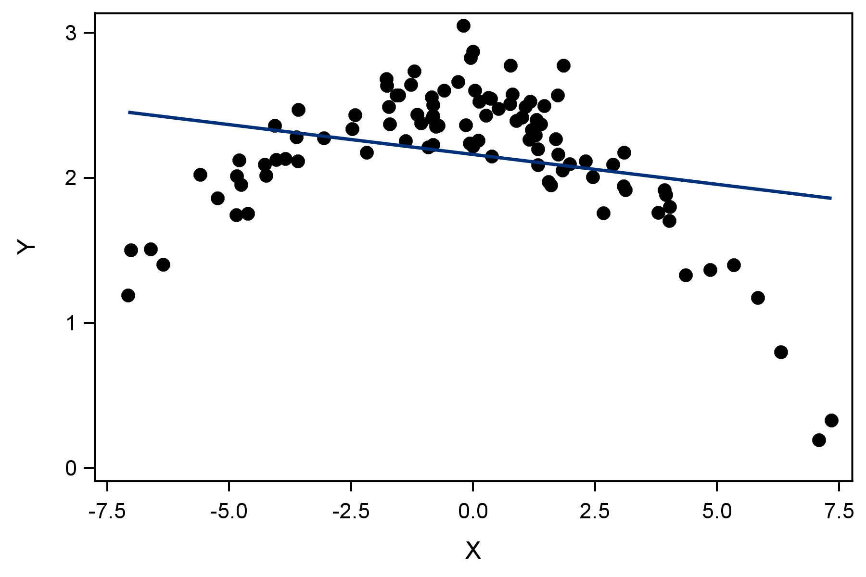
Missing Another Type of Relationship

Slide 75
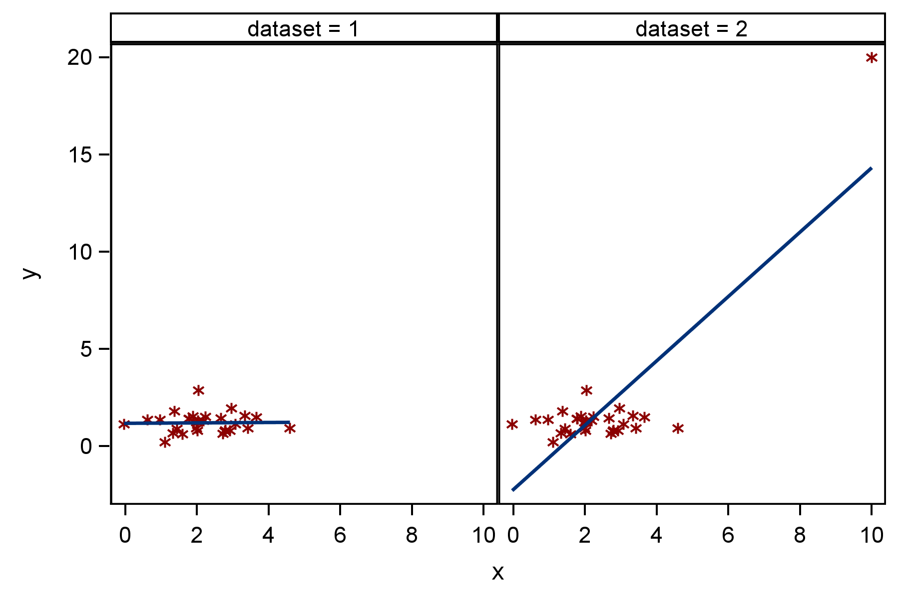
Extreme Data Values
r=0.02
r=0.82

Slide 76
The CORR Procedure
General form of the CORR procedure:
PROC CORR DATA=SAS-data-set <options>; VAR variables;
WITH variables;
ID variables;
RUN;

Slide 77
Data Exploration, Correlations, and Scatter Plots
This demonstration illustrates the concepts discussed previously.

Slide 78
Questions?

Slide 79
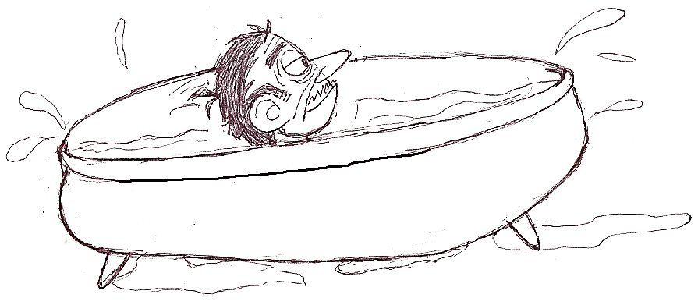
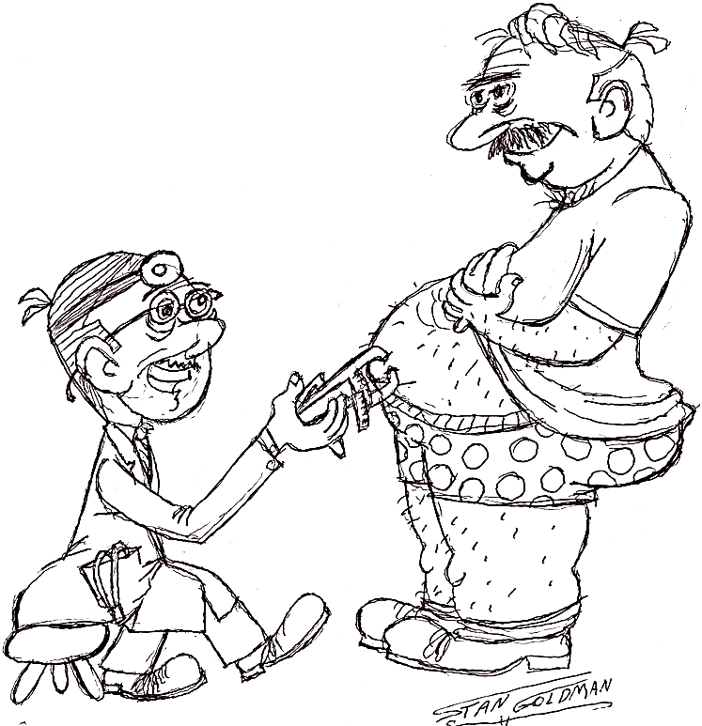
Body Fat Example

Slide 80
Exercise
This exercise reinforces the concepts discussed previously.
Notes:
Exercise 1

Slide 81
2.08 Multiple Choice Poll
The correlation between tuition and rate of graduation at U.S. colleges is 0.55. What does this mean?
The way to increase graduation rates at your college is to raise tuition.
Increasing graduation rates is expensive, causing tuition to rise.
Students who are richer tend to graduate more often than poorer students.
d. None of the above.
Notes:
The answer is d.

Slide 82
2.08 Multiple Choice Poll – Correct Answer
The correlation between tuition and rate of graduation at U.S. colleges is 0.55. What does this mean?
The way to increase graduation rates at your college is to raise tuition.
Increasing graduation rates is expensive, causing tuition to rise.
Students who are richer tend to graduate more often than poorer students.
d. None of the above.
Notes:
The answer is d.

Slide 83
Chapter 2: ANOVA and Regression
2.1 Graphical Analysis
2.2 One-Way ANOVA
2.3 ANOVA Post Hoc Tests
2.4 Pearson Correlation
2.5 Simple Linear Regression

Slide 84
Objectives
Explain the concepts of simple linear regression.
Fit a simple linear regression using the REG procedure.
Produce predicted values and confidence intervals.

Slide 85
Overview of Statistical Models
Type of Predictors Type of Response | Categorical | Continuous | Continuous and Categorical
Continuous | Analysis of Variance (ANOVA) | Ordinary Least Squares (OLS) Regression | Analysis of Covariance (ANCOVA)
Categorical | Contingency Table Analysis or Logistic Regression | Logistic Regression | Logistic Regression

Slide 86
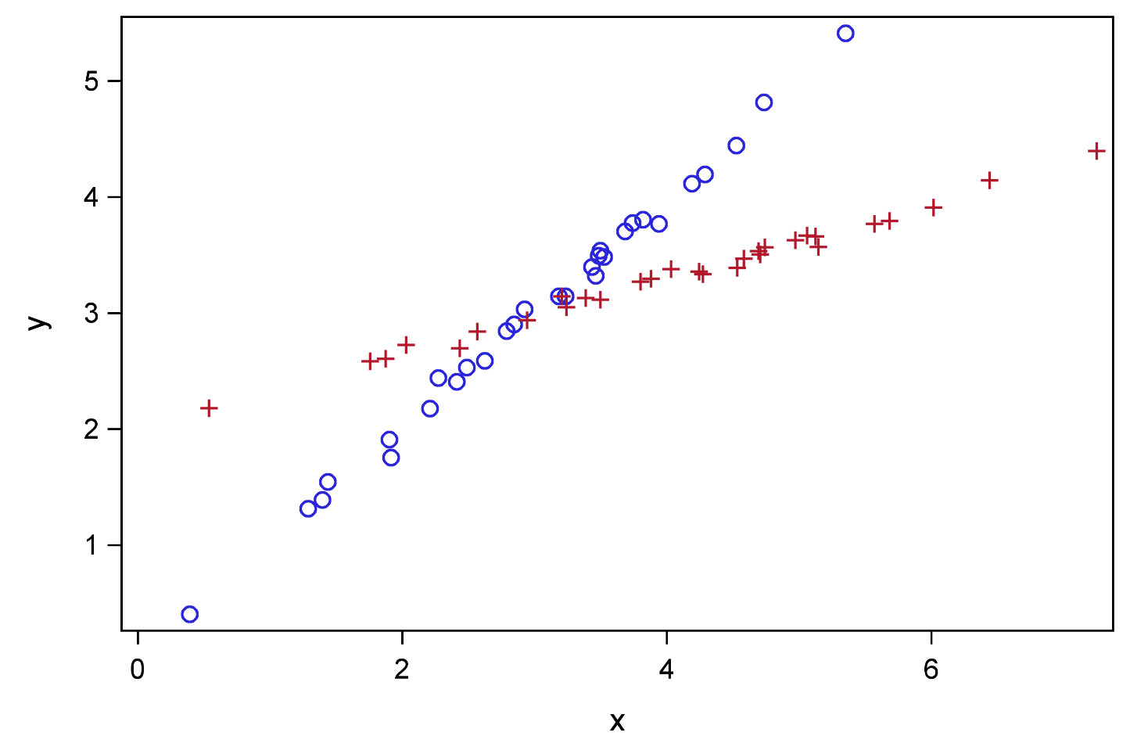
Overview

Slide 87
Simple Linear Regression Analysis
The objectives of simple linear regression are as follows:
assess the significance of the predictor variable in explaining the variability or behavior of the response variable
predict the values of the response variable given the values of the predictor variable

Slide 88
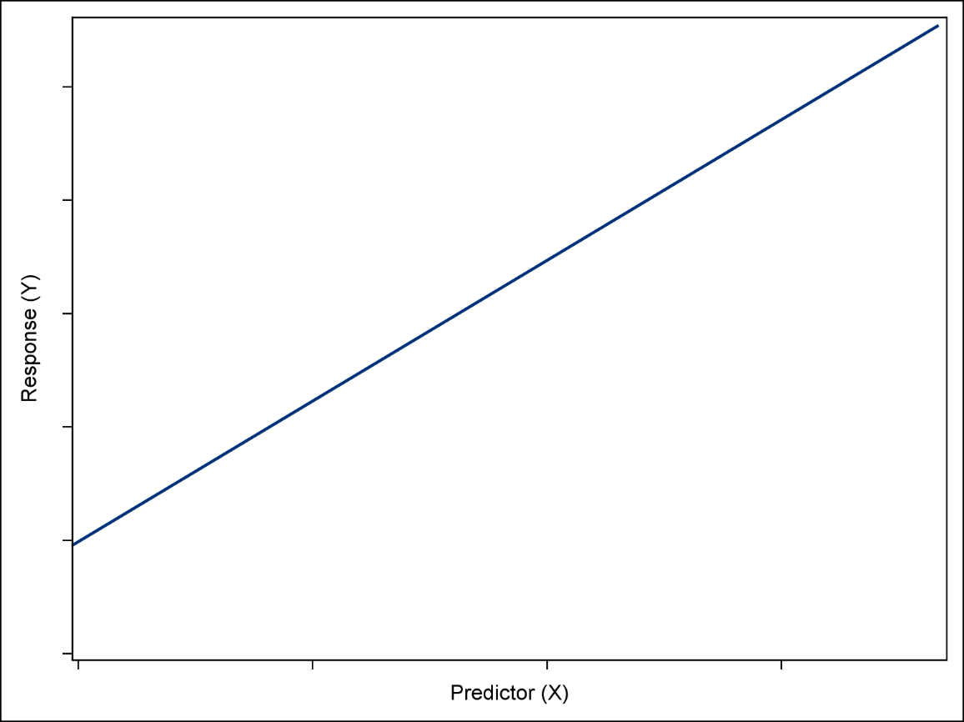
Simple Linear Regression Model
β₀ + β₁X
β₁ units
1 unit
β₀

Slide 89
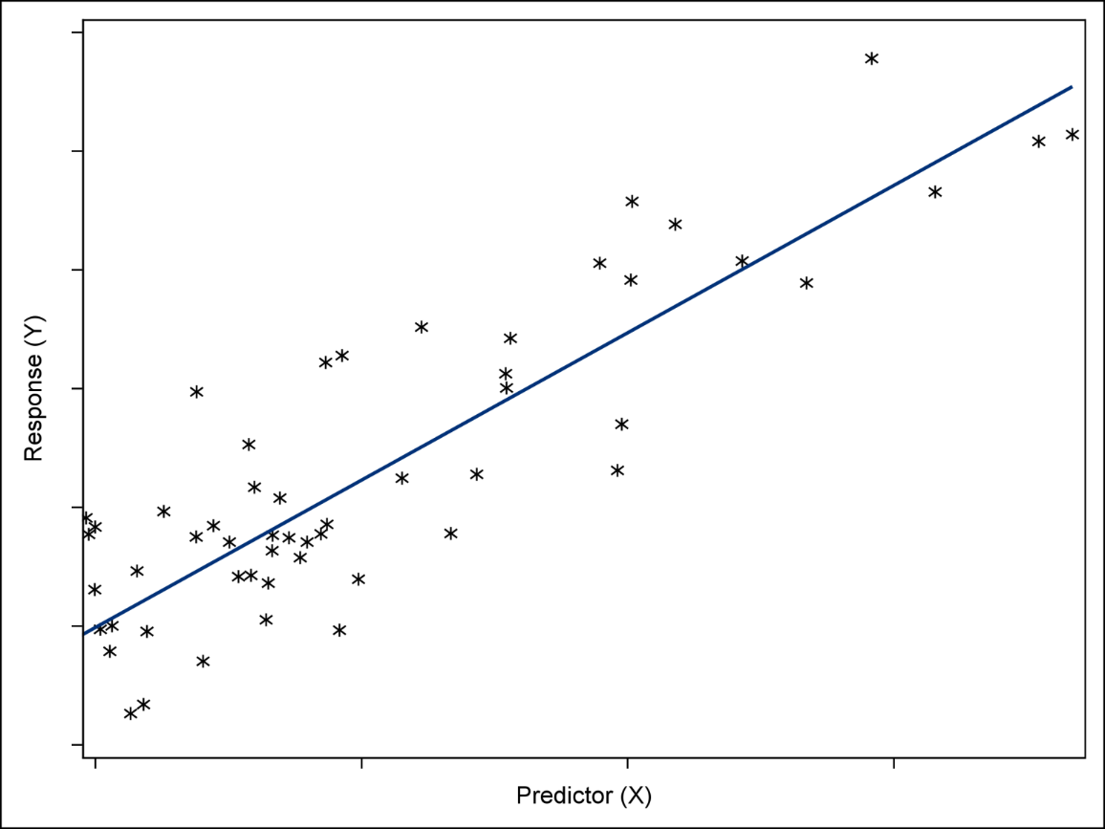
Ordinary Least Squares (OLS) Regression
Unknown Relationship
Y=β₀+β₁X
^
Y – Y
Residual
^
^
^
Y=β₀+β₁X
Regression Best Fit Line

Slide 90
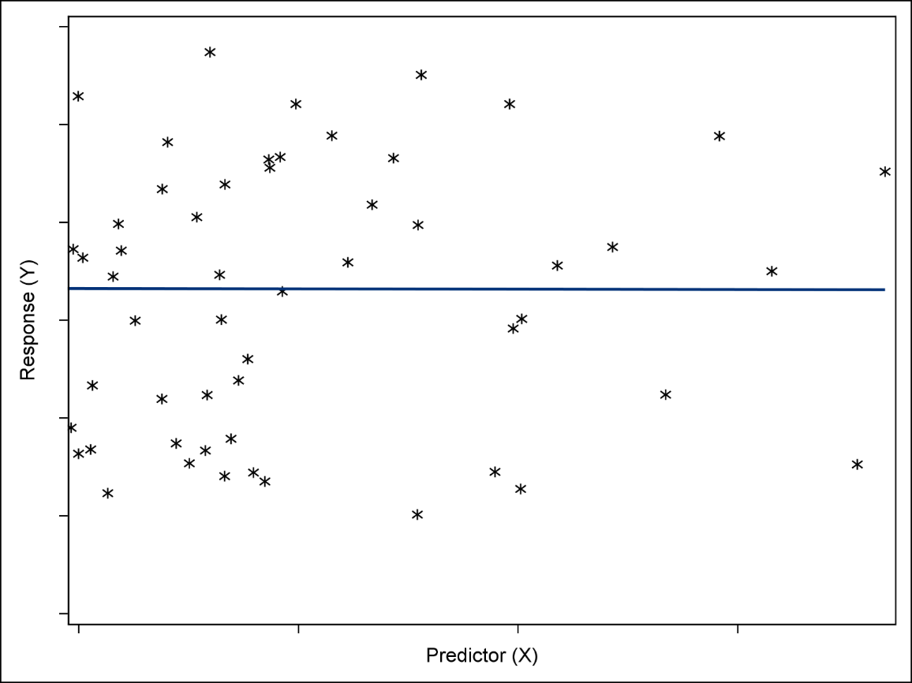
The Baseline Model (Null Hypothesis)
¯
Y

Slide 91
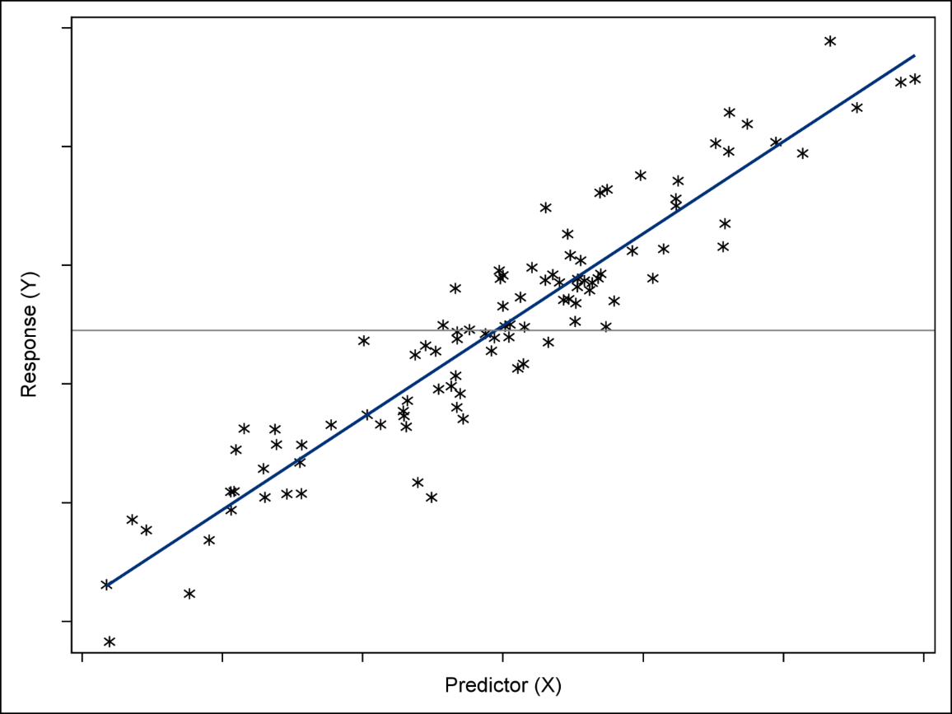
Explained versus Unexplained Variability
Unexplained
Total
¯
Y
*
Explained
^
^
^
Y=β₀+β₁X

Slide 92
Model Hypothesis Test
Null Hypothesis:
The simple linear regression model does not fit the data better than the baseline model.
β₁=0
Alternative Hypothesis:
The simple linear regression model does fit the data better than the baseline model.
β₁≠0

Slide 93
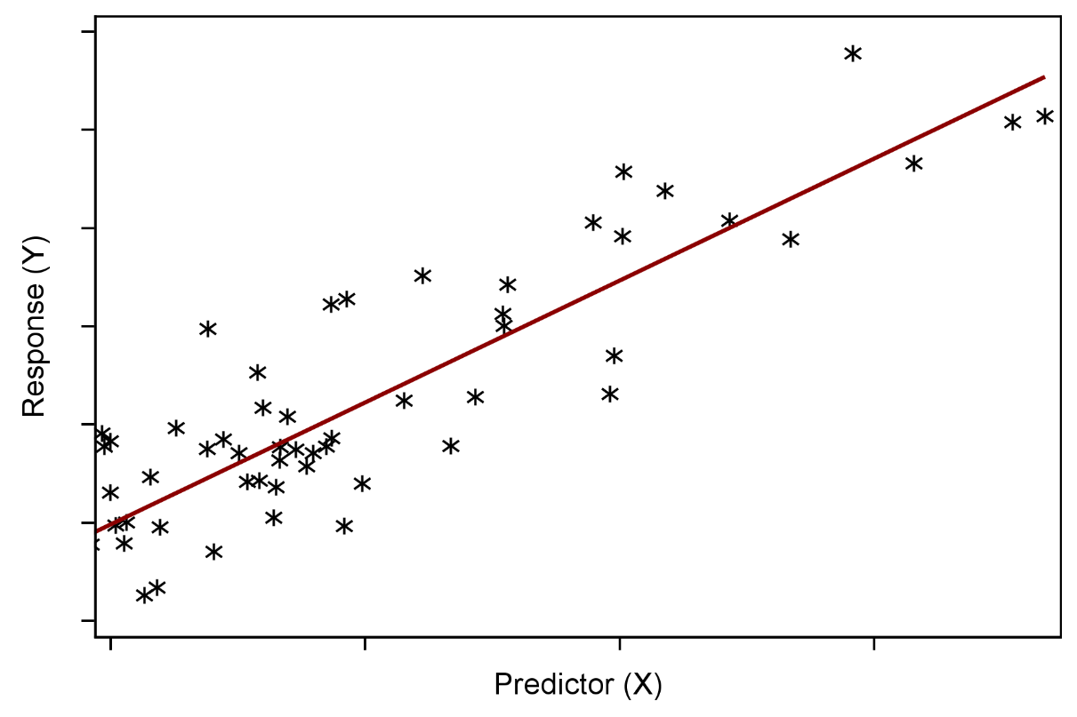
Assumptions of Simple Linear Regression
Unknown Relationship
Y=β₀+β₁X

Slide 94
The REG Procedure
General form of the REG procedure:
PROC REG DATA=SAS-data-set <options>; MODEL dependent(s)=regressor(s) </ options>;
RUN;
QUIT;

Slide 95
Sale Price Regression Example
PREDICTOR RESPONSE
Lot_Area SalePrice

Slide 96
Performing Simple Linear Regression
This demonstration illustrates the concepts discussed previously.

Slide 97
2.09 Multiple Choice Poll
Run PROC REG with this MODEL statement: model y=x1;. If the parameter estimate (slope) of x1 is 0, then the best guess (predicted value) of y when x1=13 is which of the following?
13
the mean of y
a random number
the mean of x1
0
Notes:
The answer is b.

Slide 98
2.09 Multiple Choice Poll – Correct Answer
Run PROC REG with this MODEL statement: model y=x1;. If the parameter estimate (slope) of x1 is 0, then the best guess (predicted value) of y when x1=13 is which of the following?
13
the mean of y
a random number
the mean of x1
0
Notes:
The answer is b.

Slide 99
Questions?

Slide 100
Exercise
This exercise reinforces the concepts discussed previously.
Notes:
Exercise 2

